Slide 1

Stock assessment 2: Statistical catch at age models
Elizabeth A. Babcock

Slide 2
Age structured models
Most modern high-value commercial fisheries are assessed with statistical catch at age (SCAA) models
Can model size limits, time lags in population dynamics, selectivity in fisheries, etc.

Slide 3
Data
Dat used
Abundance time series (CPUE, survey)
Catches at age and/or total catch plus samples of catch at age or length per fishery
Mean size time series, etc.
Likelihood is summed across likelihoods for all data
General philosophy is to predict all data sources in their original format and give them a likelihood, rather than transforming or summarizing, called an “integrated model”

Slide 4
Age structured stock assessment methodology
Track of number of fish at each age and year
Use life history relationships to estimate fish growth, weight, fecundity, etc.
Predict catch at age, length frequency etc.
Estimate parameters using likelihood summed across all types of data
Often include Bayesian priors on parameters
Numbers at age
Age
1 2 3 4 5
Year
2000
2001
2002
2003
2004

Slide 5
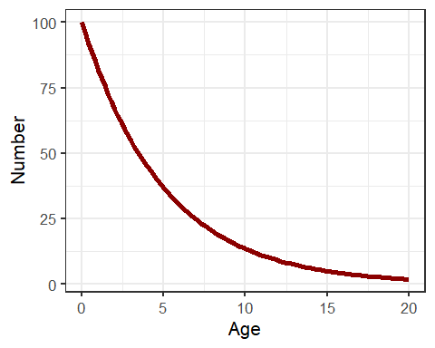
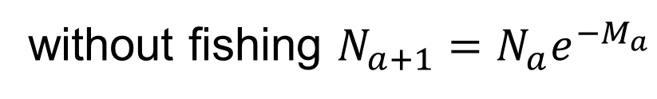
Natural Mortality (M)
without fishing $N_{a+1}={N_{a}e}^{−M_{a}}$
Ma is the instantaneous natural mortality rate at age
May be fixed, or given a Bayesian prior, or estimated freely based on a functional form like Lorenzen

Slide 6
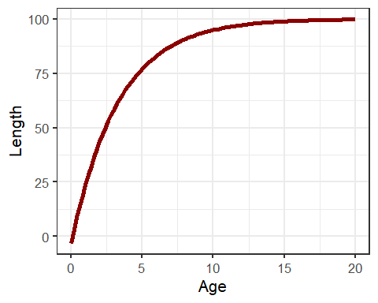

Fish Growth (von Bertalanffy)
$$L_{a}=L_{∞}\left(1−e^{−K\left(a−a_{0}\right)}\right)e^{σ}$$
Usually input as fixed parameters, often sex specific. Variance in length at
age is important, because we need the distribution of fish lengths at age.

Slide 7
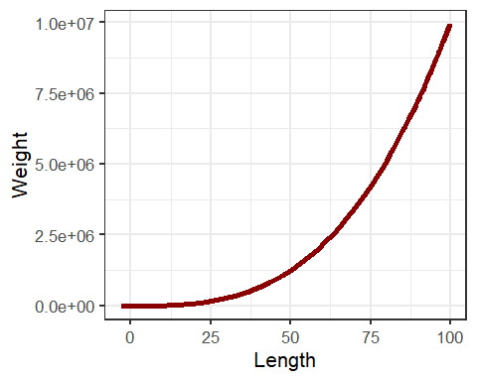
Weight as a function of length
Usually input as fixed parameters, often sex specific.

Slide 8
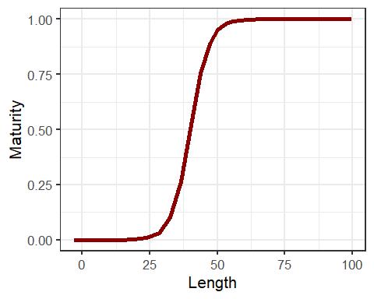
Fraction mature by age
Usually input as fixed parameters, often sex specific.

Slide 9
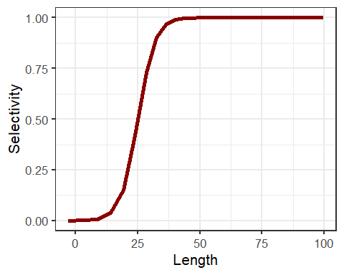
Selectivity of fishing
Estimated within the model, for each individual fleet or survey that has either catches or an abundance index
Fleets with no data may be grouped with other fleets that use similar gear
Changes in selectivity over time (e.g. changes in fishing methods) can be handled with time-blocks

Slide 10
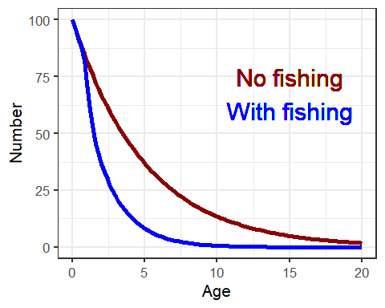

Decline in abundance with fishing
$$N_{a+1, t+1}={N_{a,t}e}^{−(M_{a}+s_{a}F_{t}) }$$
Age
Year

Slide 11
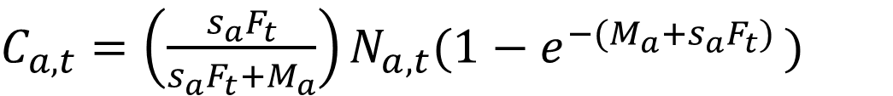
Catch in each year. Baranov catch equation
$C_{a,t}={\left(\frac{s_{a}F_{t}}{s_{a}F_{t}+M_{a}}\right)N_{a,t}(1−e}^{−(M_{a}+s_{a}F_{t}) })$
Fraction that live
Fraction of mortality
that is fishing
Fraction that die
Reported catch at age may be assumed known without error, or may have a likelihood

Slide 12
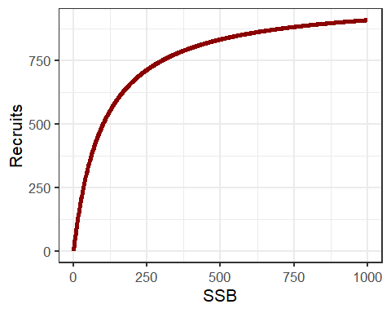
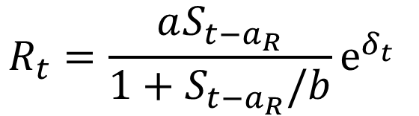
Recruitment predicted from spawning stock biomass (e.g. Beverton Holt)
$$R_{t}=\frac{aS_{t−a_{R}}}{1+S_{t−a_{R}}/b}e^{δ_{t }}$$
Recruitment model is where dependence exists in SCAA models
Log scale recruitment deviates are estimated every year, sometimes with autocorrelation

Slide 13
How to fit the model
Age
Data available
Length or age frequency distributions
Catch at age data
abundance trend data (CPUE or survey)
Use estimated parameters to predict catch, length-frequency, indices, etc.
Calculate the sum of the log-likelihood of all data, with appropriate weighting of each element
Best estimates of parameters and their uncertainty from total log likelihood or Bayesian methods
Year

Slide 14
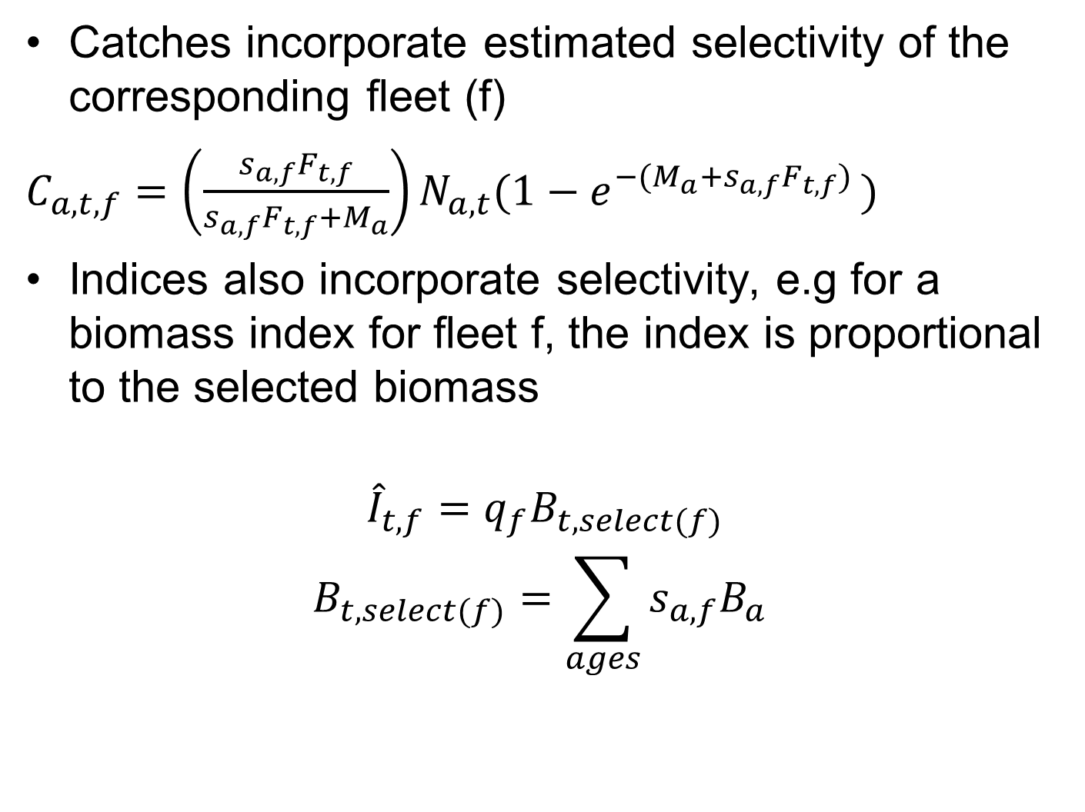
Predicting data
Catches incorporate estimated selectivity of the corresponding fleet (f)
$C_{a,t,f}={\left(\frac{s_{a,f}F_{t,f}}{s_{a,f}F_{t,f}+M_{a}}\right)N_{a,t}(1−e}^{−(M_{a}+s_{a,f}F_{t,f}) })$
Indices also incorporate selectivity, e.g for a biomass index for fleet f, the index is proportional to the selected biomass
$${\hat{I}}_{t,f}=q_{f}B_{t,select(f)}$$
$$B_{t,select(f)}=\sum_{ages}{s_{a,f}B_{a}}$$

Slide 15
Predicted numbers at length or age in a sample
If there is a sample of fish at age and length in from a fleet or survey, the expected numbers in each bin are a function of selectivity, and numbers at age and length
We know the proportion at each age in each age length, from an age x length key, or from the growth curve and its variability

Slide 16
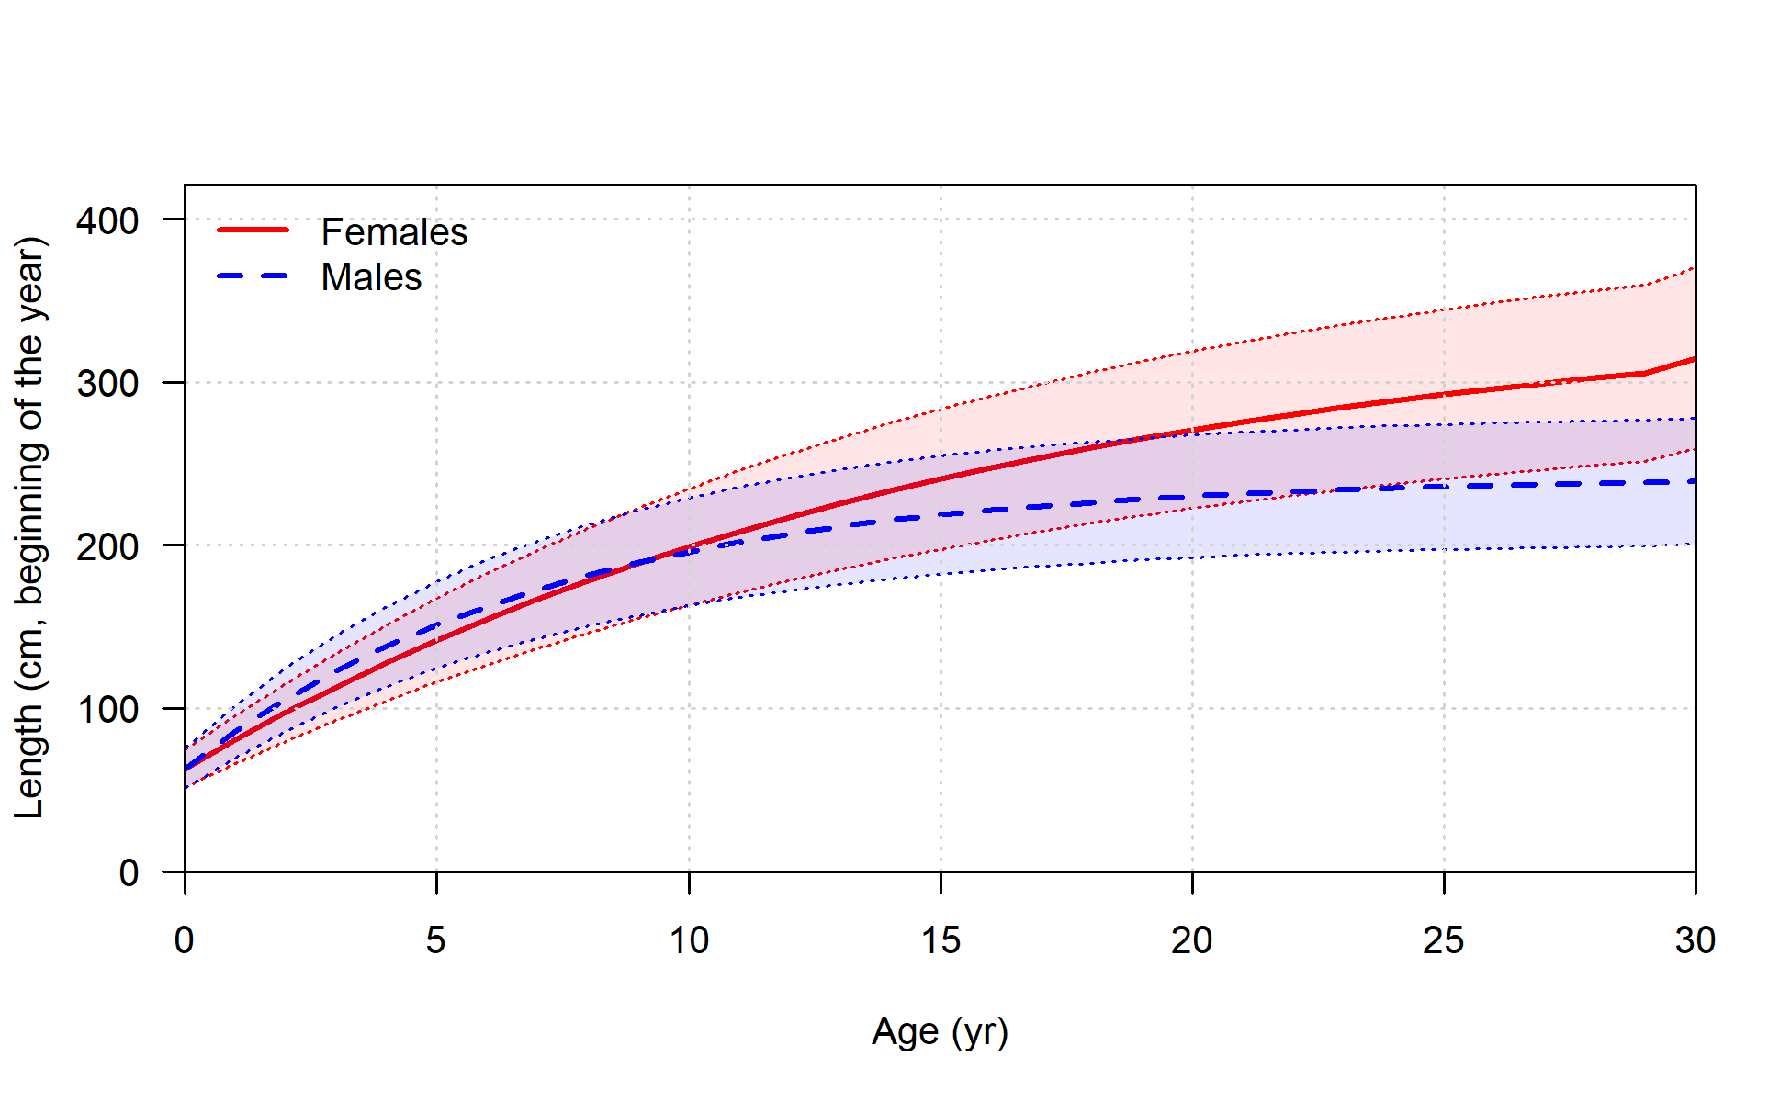
Length curve with variability

Slide 17
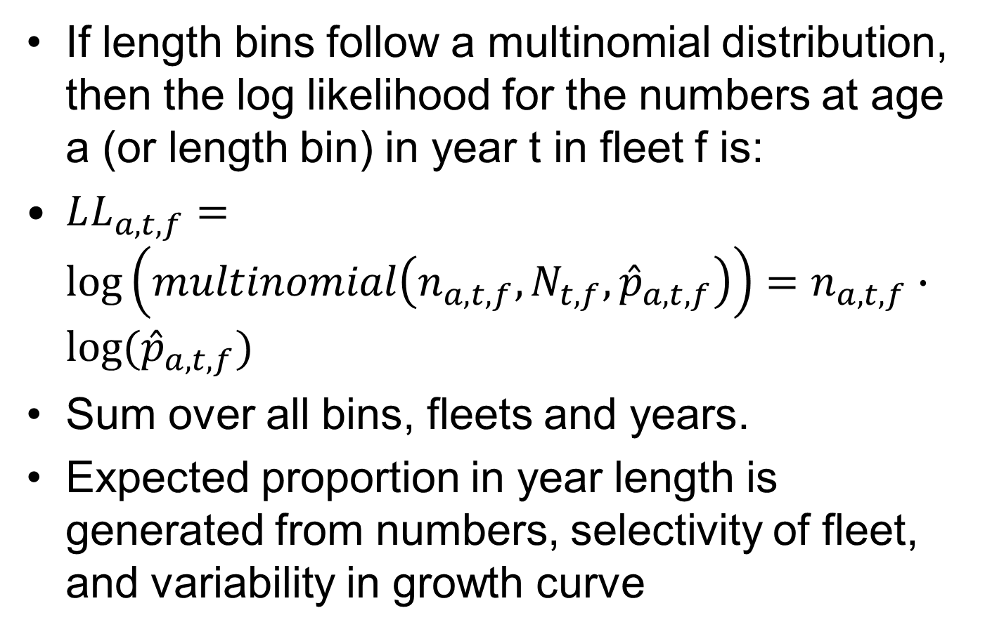
Likelihood of length or age frequencies
If length bins follow a multinomial distribution, then the log likelihood for the numbers at age a (or length bin) in year t in fleet f is:
$LL_{a,t,f}=\log\left(multinomial\left(n_{a, t,f},{N_{t,f}, \hat{p}}_{a, t,f}\right)\right)=n_{a, t,f}∙log⁡({\hat{p}}_{a, t,f})$
Sum over all bins, fleets and years.
Expected proportion in year length is generated from numbers, selectivity of fleet, and variability in growth curve

Slide 18
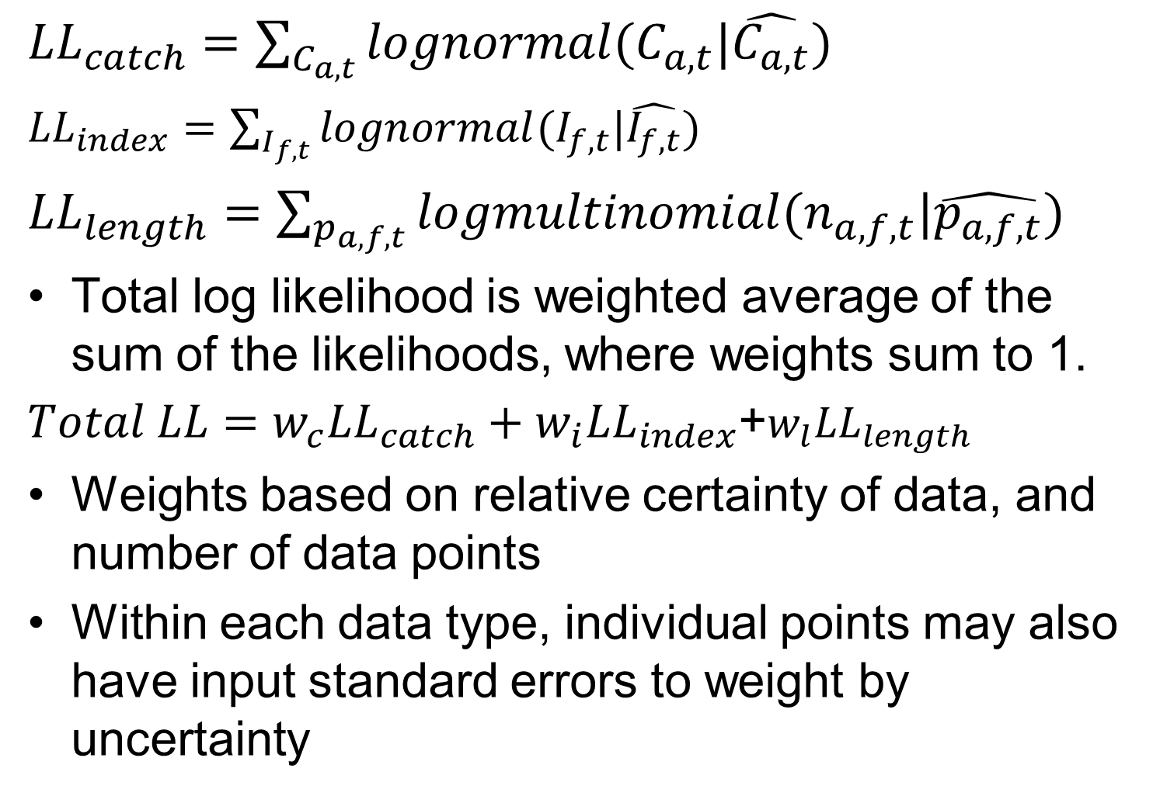
Total likelihood
${LL}_{catch}=\sum_{C_{a,t}}{lognormal(C_{a,t}|\hat{C_{a,t}})}$
${LL}_{index}=\sum_{I_{f,t}}{lognormal(I_{f,t}|\hat{I_{f,t}})}$
${LL}_{length}=\sum_{p_{a,f,t}}{logmultinomial(n_{a,f,t}|\hat{p_{a,f,t}})}$
Total log likelihood is weighted average of the sum of the likelihoods, where weights sum to 1.
$Total LL=w_{c}LL_{catch}+w_{i}LL_{index}$+${w_{l}LL}_{length}$
Weights based on relative certainty of data, and number of data points
Within each data type, individual points may also have input standard errors to weight by uncertainty

Slide 19
Workflow
Finalize data and inputs →
develop plausible base case(s) (1-3) →
check for fit and diagnostics →
run sensitivity analyses on uncertainties → produce current status →
run projections to get management advice
Often fit model at mode, then use MCMC or likelihood profile to get uncertainty

Slide 20
Fitting and diagnostics
SCAA models require the same diagnostics as production models, plus others
jittering starting guesses to be sure of convergence (may have >100 parameters)
Likelihood profiles by dataset to see which data influence which parameters
Hindcast cross-validation, retrospective analysis, residual trends, etc.
Paper by Carvahlo et al on best practices

Slide 21
Model outputs
SCAA models automatically calculate all the reference points
Fishing mortality rate reference points Fmsy, F_{0.1} from YPR, F_{30%} from SSBPR
Biomass reference points SPR, SSBmsy, etc.
Reference points are generally calculated for spawning stock biomass, so not the same as production models
Calculate current status relative to reference points with uncertainty
Projections of future population under proposed levels of fishing with uncertainty
Size based management, quotas, etc.

Slide 22
Swordfish status 2015
Production model in orange, age structured model (SS3) in blue
ICCAT 2019

Slide 23
Software for SCAA
In the US, Stock Synthesis 3 (SS3) is widely used
https://nmfs-ost.github.io/ss3-website/
There is a simple SCAA model in the FLR family of models
https://flrproject.org/
http://flrproject.org/FLa4a/
Models designed for specific uses are often written in TMB or ADMB

Slide 24
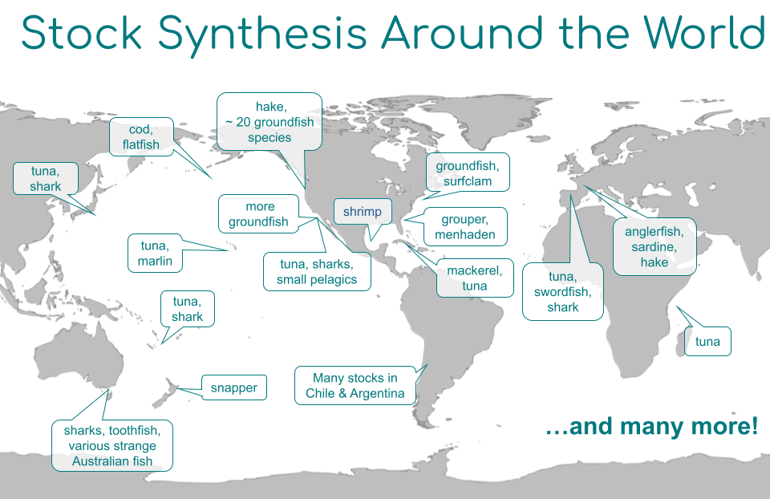
SS3
https://nmfs-ost.github.io/ss3-website/

Slide 25
Example using r4ss
https://nmfs-ost.github.io/ss3-website/
https://r4ss.github.io/r4ss/BigSkate/_SS_output_Pars.html
Shortfin mako shark 2019 https://www.iccat.int/en/assess.html
https://www.iccat.int/Documents/SCRS/ExecSum/SMA_ENG.pdf
https://www.iccat.int/Documents/SCRS/DetRep/SMA_SA_ENG.pdf

Slide 26
Shortfin Mako North Atlantic 2017
See figures run from r4ss in R

Slide 27
Diagnostics
https://nmfs-ost.github.io/ss3diags/
Carvalho et al. 2021 used North Atlantic Mako as an example to show the diagnostics
1. Jitter
2. Runs test of CPUE an length
2. Joint residual plots and RMSE
4. Log-likelihood component profiles for R0
5. ASPM
6. Retrospective patterns and Mohn’s Rho test.
7. Hindcasting cross validation

Slide 28
Diagnostic workflow
Carvalho et al. 2021

Slide 29
Convergence
SCAA models converge very badly, because they have many parameters and complex correlation.
Check that the Hessian is positive definite and will invert
Check that no parameters have very high variance
“Jitter” starting parameters to make sure all converge to the same solution

Slide 30
Jitter diagnostic
ss3diag jitter function automatically adjusts the starting guesses
Each run is one set of starting guesses
In this example, most converge to the same solution, but not all.
The solutions with the same answer are more likely to be right
Carvalho et al. 2021

Slide 31
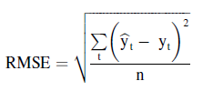
Goodness of fit
Root mean square error = standard deviation of residuals (smaller is better, but not comparable across data sources).
Runs test. Are there patterns in residuals for any data source? Are any points >3 sd from the predictive value?
Carvalho et al. 2021

Slide 32
Mako runs test
Carvalho et al. 2021

Slide 33
Data conflict
Likelihood profiles showing total –LL and –LL for each data source for key parameters, should be consistent
Most important is likelihood profile for log(R0), the log of the unfished recruitment
Carvalho et al. 2021

Slide 34
Mako likelihood profiles
Total –LL should show a strong drop at the MLE estimate.
Look for data sources that have different minima, ie support different values
Data sets with flat profiles contribute little to fit
log(R0) Carvalho et al. 2021

Slide 35
Data conflict: ASPM
ASPM: Age structure production model is a population dynamics model of intermediate complexity, between a production model and a SCAA.
Basically, a production model with selectivity
Run an ASPM with indices and catches, to see if the catches could explain the changes in indices.
If ASPM results are very different from the full model, there is a data conflict
Carvalho et al. 2021

Slide 36
Full model is SS3
ASPM is a deterministic ASPM model
ASPMDev allows for process error
Results show that the catches and indices are not consistent, unless model allows a pattern in the recruitment deviates
Carvalho et al. 2021

Slide 37
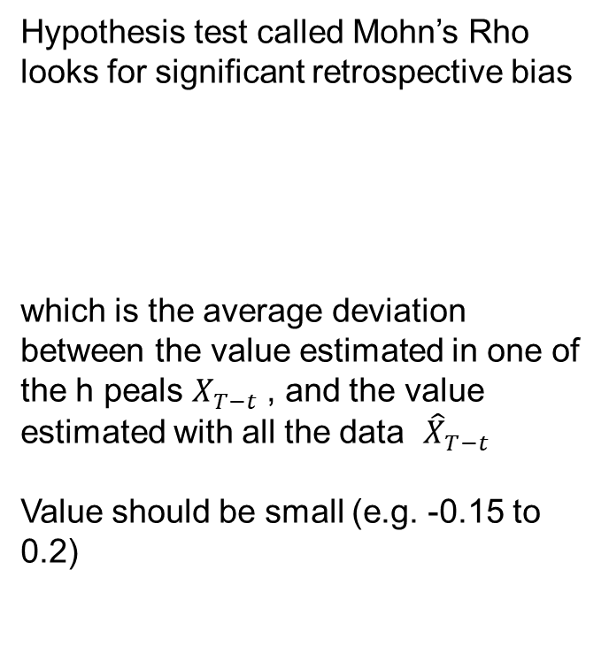
Retrospective bias?
Hypothesis test called Mohn’s Rho looks for significant retrospective bias
which is the average deviation between the value estimated in one of the h peals $X_{T−t}$, and the value estimated with all the data ${\hat{X}}_{T−t}$
Value should be small (e.g. -0.15 to 0.2)
Carvalho et al. 2021

Slide 38
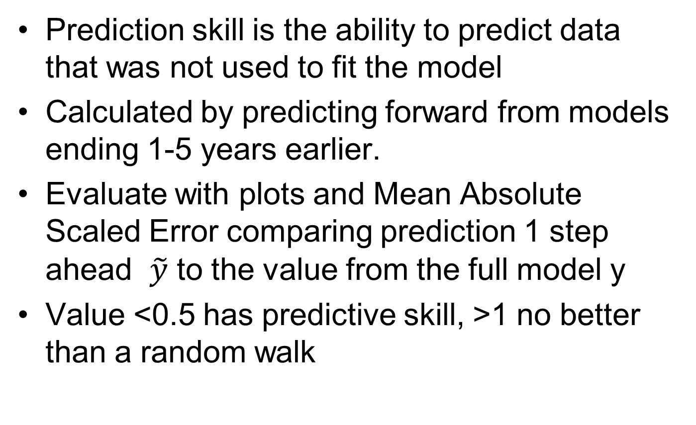
Prediction skill: hindcast cross validation HCxval
Prediction skill is the ability to predict data that was not used to fit the model
Calculated by predicting forward from models ending 1-5 years earlier.
Evaluate with plots and Mean Absolute Scaled Error comparing prediction 1 step ahead $\tilde{y}$ to the value from the full model y
Value <0.5 has predictive skill, >1 no better than a random walk

Slide 39
Mako hindcast cross-validation
Most indices and catches have values between 0.5 and 1.0
So, weak predictive skill, partly due to lack of change between years

Slide 40
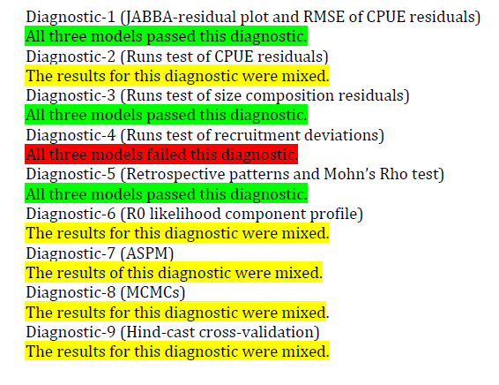
Diagnostic summary
In ICCAT stock assessment document

Slide 41
Results: Mako status 2015
Production model (pink) was much more optimistic than the SS3 model (blue)
www.iccat.int Mako executive summary

Slide 42
Mako projections SS3
www.iccat.int Mako executive summary

